Slide 1
Advance database management systems BcaE0001
Module 2

Slide 2
Syllabus
Concurrency Control Techniques:
Two Phase Locking Techniques for Concurrency Control,
Concurrency Control Based on Timestamp Ordering.
Deadlock:
Deadlock Handling,
Deadlock Prevention,
Deadlock Detection and
Deadlock Recovery Techniques.
Recovery System:
Failure Classification
Storage Structure
Data Access

Slide 3
Recovery System
A computer system, is subject to failure from a variety of causes:
disk crash,
power outage,
software error,
a fire in the machine room,
sabotage.

Slide 4
RELIABILITY : A reliable DBMS is one that can continue to process user requests even when the underlying system is unreliable, i.e., failures occur

Slide 5
Reliability
Problem:
How to maintain
Atomicity
Durability
properties of transactions
Reliability is closely related to the problem of how to maintain the atomicity and durability properties of transactions

Slide 6
Failure -------> information may be lost
Therefore, the database system must take actions in advance to ensure that the
atomicity
durability
properties of transactions, are preserved

Slide 7
Recovery Scheme
An integral part of a database system
It can restore the database to the consistent state that existed before the failure
Also provide high availability;
the time for which the database is not usable after a crash.

Slide 8
Failure Classification
Transaction failure :
Logical errors: transaction cannot complete due to some internal error condition
Ex. bad input, data not found, overflow, or resource limit exceeded
System errors: the database system must terminate an active transaction due to an error condition (e.g., deadlock)

Slide 9
Failure Classification
System crash: due to -
hardware malfunction, or
a bug in the database software or
a bug in the operating system,
Causes the loss of the content of volatile storage and,
Brings transaction processing to a halt.
Fail-stop assumption: non-volatile storage contents are assumed to not be corrupted by system crash
Database systems have numerous integrity checks to prevent corruption of disk data

Slide 10
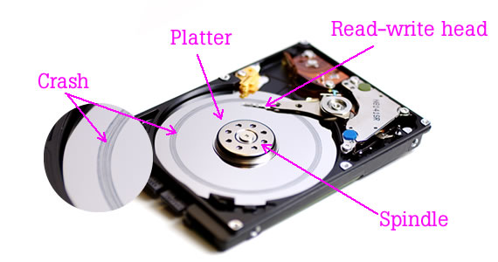
Disk failure:
a head crash or similar disk failure destroys all or part of disk storage
Destruction is assumed to be detectable: disk drives use checksums to detect failures

Slide 11
QUESTION ???
Overflow and underflow may lead to Transaction Failure, this is a……
Syntax Error
Physical Error
Logical Error
All of them

Slide 12
QUESTION ???
Overflow and underflow may lead to Transaction Failure, this is a……
Syntax Error
Physical Error
Logical Error
All of them

Slide 13
Question…………………????
A bug in the database software may lead to System Crash.
True
False

Slide 14
Question…………………????
A bug in the database software may lead to System Crash.
True

Slide 15
Question ……………?????
A Deadlock generates which kind of the error?
Ans ………

Slide 16
Question ……………?????
A Deadlock generates which kind of the error?
Ans: system errors

Slide 17
Recovery Algorithms
Consider transaction T_{i} that transfers $50 from account A to account B
Two updates: subtract 50 from A and add 50 to B
Transaction T_{i} requires updates to A and B, to be output to the database.
A failure may occur after one of these modifications have been made but before transaction commit.

Slide 18
Modifying the database without ensuring that the transaction will commit may leave the database in an inconsistent state
Not modifying the database may result in lost updates if failure occurs just after transaction commits

Slide 19
Recovery Algorithms
Recovery algorithms have two parts
Actions taken during normal transaction processing to ensure enough information exists to recover from failures
Actions taken after a failure to recover the database contents to a state that ensures atomicity, consistency and durability

Slide 20
Storage Structure
Volatile storage
does not survive system crashes
examples: main memory, cache memory
Nonvolatile storage:
survives system crashes
examples: disk, tape, flash memory, non-volatile (battery backed up) RAM
but may still fail, losing data
Stable storage:
a mythical form of storage that survives all failures
approximated by maintaining multiple copies on distinct nonvolatile media

Slide 21
Stable-Storage Implementation
Maintain multiple copies of each block on separate disks
copies can be at remote sites to protect against disasters such as fire or flooding.

Slide 22
Stable-Storage Implementation
Failure during data transfer can still result in inconsistent copies
Block transfer can result in
Successful completion
Partial failure: destination block has incorrect information
Total failure: destination block was never updated

Slide 23
Stable-Storage Implementation
Protecting storage media from failure during data transfer (one solution):
Execute output operation as follows (assuming two copies of each block):
Write the information onto the first physical block.
When the first write successfully completes, write the same information onto the second physical block.
The output is completed only after the second write successfully completes.

Slide 24
Data Access
Physical blocks are those blocks residing on the disk.
Buffer blocks are the blocks residing temporarily in main memory.

Slide 25
Block Storage Operations

Slide 26
Data Access
Block movements between disk and main memory are initiated through the following two operations:
input(B) transfers the physical block B to main memory.
output(B) transfers the buffer block B to the disk, and replaces the appropriate physical block there.
We assume, for simplicity, that each data item fits in, and is stored inside, a single block.

Slide 27
Example of Data Access
buffer
Buffer Block A
input(A)
X
A
Buffer Block B
Y
B
output(B)
read(X)
write(Y)
x₂
x₁
y₁
work area
of T₁
work area
of T₂
memory
disk

Slide 28
Example of Data Access
buffer
Buffer Block A
input(A)
X
A
Buffer Block B
Y
B
output(B)
read(X)
write(Y)
x₂
x₁
y₁
work area
of T₁
work area
of T₂
memory
disk

Slide 29
Data Access (Cont.)
Each transaction T_{i} has its private work-area in which local copies of all data items accessed and updated by it are kept.
T_{i}'s local copy of a data item X is called x_{i}.

Slide 30
Data Access (Cont.)
Transferring data items between system buffer blocks and its private work-area done by:
read(X) assigns the value of data item X to the local variable x_{i}.
write(X) assigns the value of local variable x_{i} to data item {X} in the buffer block.
Note: output(B_{X}) need not immediately follow write(X). System can perform the output operation when it deems fit.

Slide 31
Transactions
Must perform read(X) before accessing X for the first time (subsequent reads can be from local copy)
write(X) can be executed at any time before the transaction commits

Slide 32
Ques.: Which statement is/are true? ☺ ☺
input(B) transfers the physical block B from main memory to Disk.
output(B) transfers the buffer block B to the disk, and replaces the appropriate physical block there.

Slide 33
Answer:
Option B, is true and A is false
input(B) transfers the physical block B from Disk to Main memory.

Slide 34
Question: Fill in the blanks ☺
Physical blocks are those blocks residing on the………………...
Buffer blocks are the blocks residing on the…………………………….

Slide 35
Answer:
Physical blocks are those blocks residing on the disk.
Buffer blocks are the blocks residing temporarily in main memory.

Slide 36
Ques.: Fill in the blanks ☺
In Input(A) data item A’ s block is fetch from ………………..
In Read(A) data item A is fetch from ……………………….
In Output(A) data item A’s block is stored in………………
In Write(A) data item A is stored in ………………………..

Slide 37
Answer:
In Input(A) data item A’ s block is fetch from disk to main memory
In Read(A) data item A is fetch from main memory to local work area memory
In Write(A) data item A is stored in main memory
In Output(A) data item A’s block is stored in disk

Slide 38
Log Based Recovery
A log is the most popular structure for recording DB modifications on stable storage
Each log record describes an important event during transaction processing
With the information in the log file the recovery manager can restore the consistency of the DB in case of a failure.

Slide 39
Log Based Recovery …
A log record contains the required information for redoing or undoing actions.
Whenever a transaction is performed on the database, a log record is written in the log file.
The log record includes:
The identifier of the transaction
The identifier of the record
The type of action
The old record value
The new record value
Write
Log
Log
Log
Log
Log
Log
Log
Log

Slide 40
Log Based Recovery …
Types of log records
– < Ti, start >: if transaction Ti has started
– < Ti, Xi , V1, V2 >: before Ti executes a write(Xi), where V1 is the old value before the write and V2 is the new value after the write
– < Ti, commit >: if Ti has committed
– < Ti, abort >: if Ti has aborted
– < checkpoint >

Slide 41
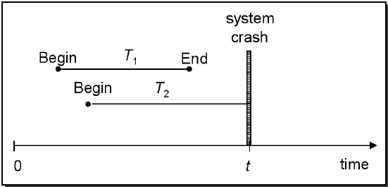
Log Based Recovery …
Assume the following situation when a system crash occurs
Upon recovery:
– All effects of transaction T1 should be reflected in the database =>(REDO)
– None of the effects of transaction T2 should be reflected in the database =>(UNDO)

Slide 42
NOTE:
Whenever a transaction performs a write, it is essential that
the log record for that write be created before the database is modified.
Once a log record exists, we can output the modification to the database if that is desirable.

Slide 43
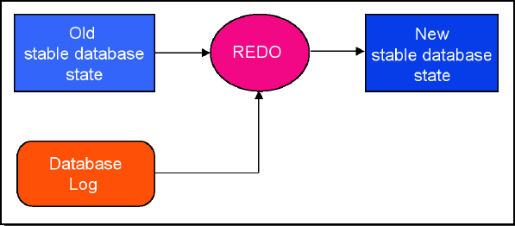
Log Based Recovery …
REDO Protocol
– The REDO operation uses the log information and performs the action that might have been done before, or not done due to failures
– The REDO operation generates the new image

Slide 44
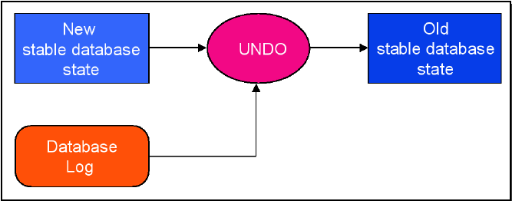
Log Based Recovery …
UNDO Protocol
– UNDO’ing an action means to restore the object to its image before the transaction has started
– The UNDO operation uses the log information and restores the old value of the object

Slide 45
Question: Which statement is/are true ?
REDO operation does not create a new database image.
UNDO operation creates a new database image.

Slide 46
Answer:
Both option are False.

Slide 47
Question: Output(B) is performed first then Write(B)….True/False

Slide 48
Answer:
False

Slide 49
Two Approaches using Logs
Deferred Database Modification
Immediate Database Modification

Slide 50
Deferred Database Modification
The deferred database modification scheme records all modifications to the log, but defers all the writes to after partial commit.
Assume that transactions execute serially
Transaction starts by writing <T_{i} start> record to log.
A write(X) operation results in a log record <T_{i}, X, V> being written, where V is the new value for X
Note: old value is not needed for this scheme
The write is not performed on X at this time, but is deferred.
When T_{i} partially commits, <T_{i} commit> is written to the log
Finally, the log records are read and used to actually execute the previously deferred writes.

Slide 51
Deferred Database Modification
Types of records:
<Ti, start>
<Ti, x, v>
<Ti, commit>
During recovery after a crash, a transaction needs to be redone if and only if both <T_{i} start> and<T_{i} commit> are there in the log.
Redoing a transaction T_{i} ( redoT_{i}) sets the value of all data items updated by the transaction to the new values.

Slide 52
Deferred Database Modification
Example Transactions T0 and T1 (T0 executes before T1):
T0: read(A)
A:=A-50
write(A)
read(B)
B:=B+50
write(B)
T1: read(C)
C:=C+100
write(C)

Slide 53
Deferred DB Modification
Log Records
Database
Read(A,a1)
a1=a1-50
Write(A,a1)
Read(B,b1)
b1=b1+50
Write(B,b1)
Commit
< T1 Starts>
T1
< T1,A,950>
A=1000
A=950
< T1,B,2050>
B=2000
< T1 Commit>
B=2050
T2
read(C,c1)
c1=c1+100
Write(C,c1)
Commit
< T2 Starts>
C=600
< T2,C,700>
C=700
< T2 Commit>

Slide 54
Deferred Database Modification
Below we show the logs as it appears at three instances of time:
<T0, start>
<T0, A, 950>
<T0, B, 2050>
(a)
<T0, start>
<T0, A, 950>
<T0, B, 2050>
<T0, commit>
<T1 start>
<T1, C, 600>
(b)
<T0, start>
<T0, A, 950>
<T0, B, 2050>
<T0, commit>
<T1 start>
<T1, C, 600>
<T1 commit>
(c)
If log on stable storage at time of crash as in case:
No redo actions need to be taken
redo(T₀) must be performed since <T₀ commit> is present
redo(T₀) must be performed followed by redo(T₁) since
<T₀ commit> and <T_{i} commit> are present

Slide 55
Immediate Database Modification
Allows database updates of an uncommitted transaction to be made as the writes are issued.
Since undoing may be needed, update logs must have both old value and new value.
Types of Records:
<Ti, start>
<Ti, x, v1, v2>
<Ti, commit>
Update log record must be written before database item is written.
We assume that the log record is directly output to stable storage.

Slide 56
Immediate DB Modification
Log Records
Database
Read(A,a1)
a1=a1-50
Write(A,a1)
Read(B,b1)
b1=b1+50
Write(B,b1)
Commit
< T1 Starts>
A=950
A=1000
< T1,A,1000,950>
B=2050
T1
B=2000
< T1,B,2000,2050>
< T1 Commit>
read(C,c1)
c1=c1+100
Write(C,c1)
Commit
< T2 Starts>
C=600
T2
C=700
< T2,C,600,700>
< T2 Commit>

Slide 57
Immediate Database Modification
Recovery procedure has two operations instead of one:
undo(T_{i}) restores the value of all data items updated by T_{i} to their old values, going backwards from the last log record for T_{i}
redo(T_{i}) sets the value of all data items updated by T_{i} to the new values, going forward from the first log record for T_{i}

Slide 58
When recovering after failure:
Transaction T_{i} needs to be undone if the log contains the record <T_{i} start>, but does not contain the record <T_{i} commit>.
Transaction T_{i} needs to be redone if the log contains both the record <T_{i} start> and the record <T_{i} commit>.
Undo operations are performed first, then redo operations.

Slide 59
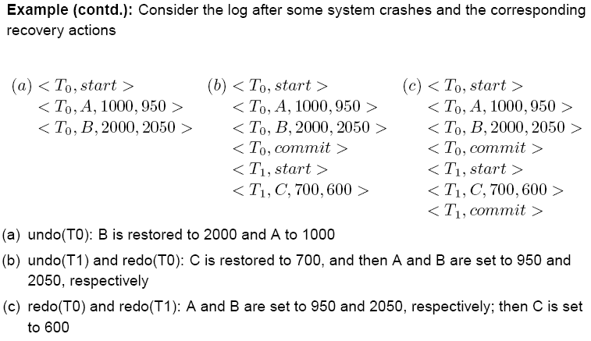

Slide 60
Checkpoints
When a system failure occurs,
we must consult the log
determine those transactions
that need to be redone and
that need to be undone.

Slide 61
Checkpoints
Problems in Recovery Procedure:
Searching the entire log is time-cosuming
We might unnecessarily redo transactions which have already output their updates to the database.

Slide 62
Checkpoints
Solution is simplify recovery procedure by periodically performing check-pointing.
Output all log records currently residing in main memory onto stable storage.
Output all modified buffer block to the disk.
Write a log record <checkpoint> onto stable storage.

Slide 63
Checkpoints (Cont.)
During recovery we need to consider only the most recent transaction T_{i} that started before the checkpoint, and transactions that started after T_{i}.
Scan backwards from end of log to find the most recent <checkpoint> record
Continue scanning backwards till a record <T_{i} start> is found.
Need only consider the part of log following above start record. Earlier part of log can be ignored during recovery, and can be erased whenever desired.
For all transactions (starting from T_{i} or later) with no <T_{i} commit>, execute undo(T_{i}). (Done only in case of immediate modification.)
Scanning forward in the log, for all transactions starting from T_{i} or later with a <T_{i} commit>, execute redo(T_{i}).

Slide 64
Example of Checkpoints
Tc
Tf
T1
T2
T3
T4
checkpoint
system failure
T1 can be ignored. (updates already output to the disk due to checkpoint).
T2 and T3 redone,
T4 undone.

Slide 65
Types of Transactions
T₁
T₂
T₃
T₄
T₅
Last Checkpoint
System Failure

Slide 66
System Recovery
Any transaction that was running at the time of failure needs to be undone and restarted
Any transactions that committed since the last checkpoint need to be redone
Transactions of type T₁ need no recovery
Transactions of type T₃ or T₅ need to be undone and restarted
Transactions of type T₂ or T₄ need to be redone

Slide 67
Transaction Recovery Algorithm
Let, UNDO and REDO: lists of transactions
UNDO = all transactions running at the last checkpoint
REDO = empty
For each entry in the log, starting at the last checkpoint
If a BEGIN TRANSACTION entry is found for T
Add T to UNDO
If a COMMIT entry is found for T
Move T from UNDO to REDO

Slide 68
Transaction Recovery
T₁
T₂
T₃
T₄
T₅
Checkpoint
Failure
UNDO: T₂, T₃
Last Checkpoint
Active transactions: T₂, T₃
REDO:

Slide 69
Transaction Recovery
T₁
T₂
T₃
T₄
T₅
Checkpoint
Failure
UNDO: T₂, T₃, T₄
T4 Begins
Add T₄ to UNDO
REDO:

Slide 70
Transaction Recovery
T₁
T₂
T₃
T₄
T₅
Checkpoint
Failure
UNDO: T₂, T₃, T₄, T₅
T₅ begins
Add T₅ to UNDO
REDO:

Slide 71
Transaction Recovery
T₁
T₂
T₃
T₄
T₅
Checkpoint
Failure
UNDO: T₃, T₄, T₅
T₂ Commits
Move T₂ to REDO
REDO: T₂

Slide 72
Transaction Recovery
T₁
T₂
T₃
T₄
T₅
Checkpoint
Failure
UNDO: T₃, T₅
T₄ Commits
Move T₄ to REDO
REDO: T₂, T₄

Slide 73
Question 1. TRUE / FALSE ?
We can state a typical deferred update protocol as follows:
A transaction cannot change the database on disk until it reaches its commit point.
There is REDO & UNDO operation

Slide 74
Answer:
There is only REDO operation in deferred update protocol
True: A only

Slide 75
Question 2. Fill in the blanks
The immediate-modification technique allows database modifications to be output to the database while the transaction is still in the………….. state.

Slide 76
Answer
Active state

Slide 77
Question 3. Fill in the blanks
The deferred-modification technique ensures transaction atomicity by recording all database modifications in the log, but deferring the execution of all write operations of a transaction until the transaction reaches in …………….state.

Slide 78
Answer
Partially commits

Slide 79
Question 4.
Consider the following log sequence of two transactions on a bank account, with initial balance 12000, that transfer 2000 to a mortgage payment and then apply a 5% interest.
T1 start
T1 B old=12000 new=10000
T1 M old=0 new=2000
T1 commit
T2 start
T2 B old=10000 new=10500
T2 commit
Suppose the database system crashes just before log record 7 is written. When the system is restarted, which one statement is true of the recovery procedure?
We must redo log record 6 to set B to 10500
We must undo log record 6 to set B to 10000 and then redo log records 2 and 3.
We need not redo log records 2 and 3 because transaction T1 has committed.
We can apply redo and undo operations in arbitrary order because they are idempotent

Slide 80
Answer:
Answer: (B) Explanation: We must undo log record 6 to set B to 10000 and then redo log records 2 and 3 because system fail before commit operation. So we need to undone active transactions(T2) and redo committed transactions (T1)

Slide 81
Question 5.
If a crash happens now and the system tries to recover using both undo and redo operations, what are the contents of the undo list and the redo list
Undo: T3, T1; Redo: T2
Undo: T3, T1; Redo: T2, T4
Undo: none; Redo: T2, T4, T3; T1
Undo: T3, T1, T4; Redo: T2
Consider the following set of operations in the log.
(start, T4)
(write, T4, y, 2, 3)
(start, T1)
(commit, T4)
(write, T1, z, 5, 7)
(checkpoint)
(start, T2)
(write, T2, x, 1, 9)
(commit, T2)
(start, T3)
(write, T3, z, 7, 2)

Slide 82
Answer
Answer: (A) Explanation: Since T1 and T3 are not committed yet, they must be undone. The transaction T2 must be redone because it is after the latest checkpoint.

Slide 83
Question 6.
In SYSTEM CRASH which memory content will be lost?
Volatile Memory
Non Volatile Memory
Both
None

Slide 84
Answer:
Volatile Memory

Slide 85
Question 7.
A transaction fails due to
Logical Error
System Error
System Crash

Slide 86
Answer
Ans: A & B

Slide 87
Question 8.
Logs are stored in..
Cache Memory
Main Memory
Disk
None

Slide 88
Ans. Disk

Slide 89

Any Questions ?

